Slide 1

Techniques in Biotechnology
Review of:
Gene Therapy
Cell Replacement Therapy
Tissue Engineering

Slide 2
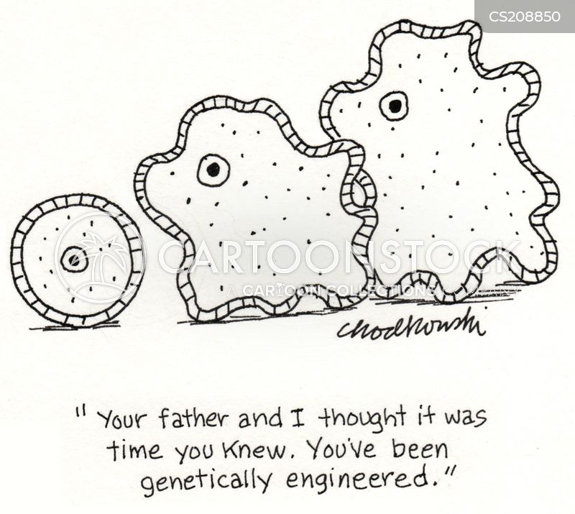
Date: | Human Biology Year 12 ATAR
Do Now Past exam question Lesson Agenda 1: Do Now 2: Review gene therapy, cell replacement therapy and tissue engineering 3: Lesson summary and wind-up Suggested Study Read through today’s notes and textbook section NEXT LESSON Intro: Biotechnology and Evidence for Evolution | Learning Aims Review understandings of gene therapy, cell replacement therapy and tissue engineering.
 | Key Vocabulary Gene Base sequence Vector Recombinant

Slide 3
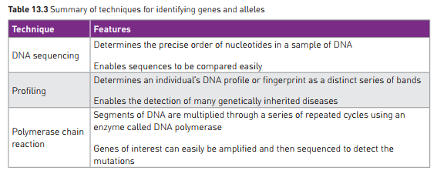

Slide 4
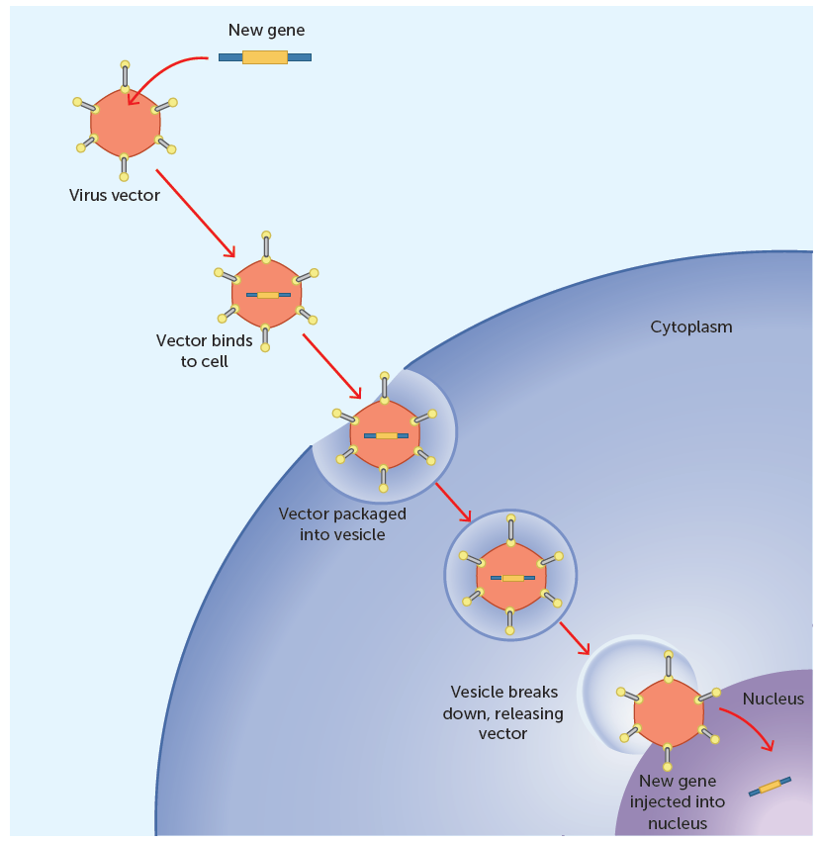
Gene Therapy
Aims to treat or cure disease by identifying faulty genes and inserting healthy ones.
Still in research phase.
Concept is that a vector (eg a virus)can be used to deliver the desired DNA into the cell, to be incorporated by the nucleus and produce desired protein.
Areas of possibility:
Replacing mutated gene with healthy copy*
Eg Huntington’s disease, Cystic Fibrosis, Type I Diabetes
Fixing or inactivating mutant genes*
Eg Huntington’s disease
Inserting a new gene that will fight the disease
Making the immune system recognise diseased cells.
Eg therapy for some cancers
*These ones could be used for Huntington’s Disease

Slide 5
Gene Therapy: Cystic Fibrosis
Cystic Fibrosis is relatively common
Recessive condition, due to faulty gene:
Cystic Fibrosis Transmembrane Regulator (CFTR)
Discovered in 1989
Causes inability of body to process certain secretions
Buildup of mucus in lungs, and digestive tract
Can significantly shorten life
First experimental gene therapy given in 1993
Used the common cold virus as vector to carry the normal gene into lungs
Mainly assessed safety of procedure
Not yet used as therapy, still in research phase.

Slide 6
Cell Replacement Therapy
Uses stem cells
Undifferentiated
Can continue repeated divisions over long periods of time
Can differentiate into other cell types in the right conditions
Often sourced from embryos
Stem cell replacement therapy
Especially for neurological diseases eg:
Parkinson’s
Alzheimer’s
Some success in pilot studies so far.
Controversial due to use of embryonic tissue

Slide 7
Cell Replacement Therapy
Could be used in future for neurodegenerative disorders such as Alzheimer’s and Parkinson’s.
Replacement of dying neurons with healthy ones derived from stem cells
Can grow and differentiate to replace damaged tissue
Controversy surrounding use of human embryonic stem cells
Other sources of stem cells are being researched
Technique not yet refined – is a potential future treatment.

Slide 8
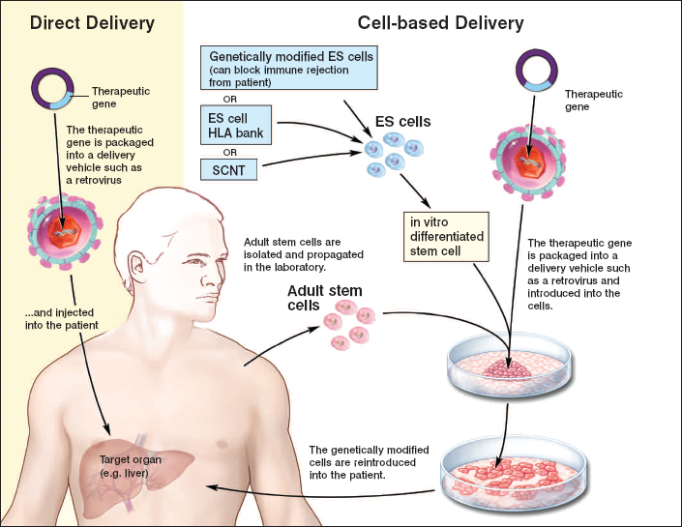
How Cell Replacement therapy might work once it is through the experimental stage:
This example shows the liver as the target organ, but the idea is the same for diseases such as Alzheimer’s and Parkinson’s where a part of the brain is the target.

Slide 9
Tissue Engineering
Also uses stem cells to:
Restore healthy tissues or organs
Eliminate the need for transplants and implants
Cells grown over natural or synthetic scaffold to make new organ or tissue
Scaffolds need to have
High pore sizes so cells can grow and nutrients can diffuse
Be degradable so they break down as the cells grow
Stem cells must be cultured
Seeded onto scaffold
Could be used to develop tissues such as bone, skin, cartilage, adipose tissue.

